Slide 1
Comparative Study
By: Henry Locke
This comparative study will break down the formal qualities, themes, cultural contexts, and art styles of the acclaimed artist Fan Ho and Paul Calhoun. I will focus on the artists’ creative processes and interpretations of their work. While both artists have vast collections of work I will be focusing on two photos from Fan Ho and two photos from Paul Calhoun, both artists worked in the medium of photography and more so both use the dated technique of film photography. Regardless of the time period of both artists they both pursued capturing social changes and dynamics around the world. Much of my own artwork has been inspired by the creative visions of Fan Ho and Paul Calhoun. Both artists have very different approaches to their artwork and their local cultures, this will be highlighted in my comparative study.

Slide 2
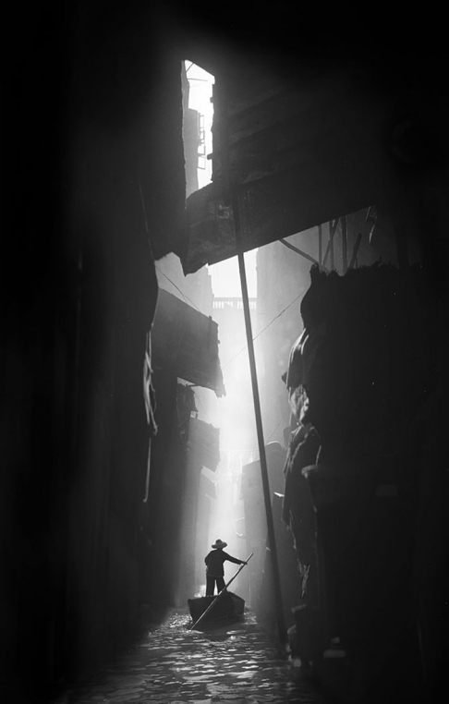
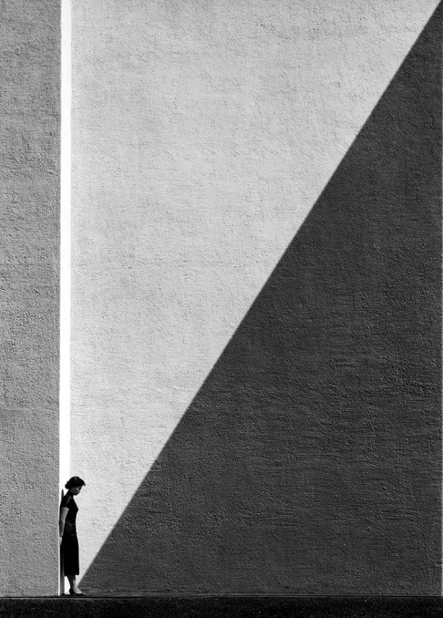
Cultural context of Fan Ho
“My belief in art creation is to try anything.” – Fan Ho
With the rise of 35mm film as well as the rise of new buildings due to the influx of immigrants from China after the People’s Republic of China was established, Fan Ho sought to capture Hong Kong's streets with his Rolleiflex twin-lens camera. Fan Ho didn’t initially begin photographing in Hong Kong, his first photos were actually taken in Shanghai with his dad’s Kodak Brownie camera. He taught himself to be patient and wait for the perfect moment to snap a picture. Much of his inspiration was drawn from the French photographer Henri Cartier-Bresson, he too waited for natural lighting, people, and weather to inspire him before taking a picture. Fan Ho hadn’t initially landed on photography as his chosen medium when he was still a young child he watched many films alone and was inspired to become a writer. When he finally escaped away to Hong Kong, he began to attend college at St Paul’s College (one of the best in Hong Kong). He was top of his class and even earned himself the nickname “Bah Gam” which translates to “great scholar”, eventually he was allowed to his assignments and writing at home whereas others were required to stay in school. Unfortunately, he overdid his work and studied to the point of getting awful migraines during his writing. After not being offered any help from doctors he found the best way to relieve his pain was to walk outside and breath the fresh air. This is when he became aware of the magnificence of Hong Kong’s streets. On his walks he started snapping pictures of the streets, he was particularly captivated by the dynamic lighting the growing city created. After taking 1st place in a local photography contest he began to pursue telling his stories that he couldn’t write through the medium of photography.
Hong Kong Venice , 1962, Fan Ho
“I took pictures according to my instinct. I didn’t find anything in particular that was attractive. I just took photographs the way I saw it and didn’t follow any particular master, style or philosophy.” – Fan Ho
Approaching Shadow, 1954, Fan Ho

Slide 3
Analysis of Ho’s Formal Qualities
“My belief in art creation is to try anything.” – Fan Ho
One of the many qualities of Fan Ho’s work is the common theme of contrasting organic forms with industrial/geometric shapes. Whereas many photographers of his era were focused on developing photojournalism, Fan Ho focused on showing people being dwarfed in the growing region of Hong Kong. By dwarfing people Ho desired to emphasize the impact of mass immigration and growth on the common people of Hong Kong. For most of Ho’s photos he would have to wait for days and sometimes months to get the perfect lighting, composition, and subject. However, in Approaching Shadow, he deliberately posed his cousin against a pure white wall and her gaze down. He later revealed that there was no shadow on this wall at all and he treated the film to darken part of the wall. Through this forced juxtaposition of light and dark Ho communicates that he youth will soon fade away and that all of humanity has the same destiny. Dark tones are used to imbue his photos with a sense of mystery and tantalization of what the darkness holds. Ho was a master of lighting and lines, he used the environment to create leading lines to his subjects. His piece Hong Kong Venice perfectly shows how he composed the shot to have multiple leading lines bringing the viewers eye to the subject.
Light beams direct attention to the man in the boat
The shades and poles act as leading lines to direct the viewer
The man is dwarfed by walls
A sense of symmetry is given off by the lighting
Wall and shadow act as an arrow to the subject
The woman is dwarfed by wall
Hong Kong Venice , 1962, Fan Ho
Approaching Shadow, 1954, Fan Ho

Slide 4
Interpretation of function and purpose
“My belief in art creation is to try anything.” – Fan Ho
The girl present in this photo is actually Fan Ho’s cousin who he happened to be walking through the Causeway Bay with when he saw this large empty wall and was inspired to compose a shot with her leaned up against a portion of the wall.
Fan Ho has always been a purest when it comes to developing and editing his shots, all of his photos were developed by himself in a darkroom. However in some of his later photograph series he began to play with light manipulation. This shot in particular was manipulated in his darkroom to be severely darkened in a diagonal line shadowing the piece. According to an interview with Fan Ho this was to symbolize the onset of old age and how everyone is moving towards the same impending fate. While this theme is very dark his later works tend to have less existential themes and generally just show the working class being dwarfed by the city.
It was later revealed that the stark contrast between light and shadow is supposed to be a juxtaposition between life and death. In reference to Fan Ho’s quote “My belief in art creation is to try anything.” this shot is an exploration of him trying to express his direct emotions in regards to a rather grim reality that we all will die. He used a woman when composing this shot not only because she was his cousin but also because young women are frequently used as symbols of youth and are more easily interpreted as such by the common viewer.
This photo is primarily negative space which is a huge contrast from the majority of his portfolio. It can be inferred that this space is to signify how small we are in this world. Just like his other works show the city of Hong Kong dwarfing workers, here we can see the wall as a metaphor for the rest of world and the girl being just another drop in the bucket.
Approaching Shadow, 1954, Fan Ho

Slide 5
Interpretation of function and purpose
“My belief in art creation is to try anything.” – Fan Ho
Now similarly to his piece Approaching Shadow and various other works the subject is a person who is completely alone. This is somewhat ironic seeing as Hong Kong in the 1950’s through the present has always had a robust and dense population that is almost always photographed in the masses to show it’s magnitude. However Fan Ho saw this massive population and decided to isolate it’s individuals, something that would rarely ever happen. Perhaps he did this to add a dreamy aspect to his shots that cannot be seen when all of humanity is on display. Additionally when it comes to identifying the significance of the subject it is important to note that Fan Ho always waited to capture the right person at the best angle. Since he shot on film he didn’t get second chances so he would patiently wait to see someone with the right character about them and then waited for the shot to line itself up.
Here once again Fan Ho can be seen manipulating light to achieve a clean silhouette and vignette on the background. Now while the light ray does create a unique dynamic in the piece it is actually symbolic of the person working towards their dreams even though the city can be seen almost closing up around them and swallowing the light. It can easily be said that living in a city so large with so many people it could be pretty easy to feel insignificant and belittled. Perhaps Fan Ho felt this way about pursuing his dreams seeing as he had his passion of writing taken away from him due to medical reasons at a relatively young age.
With the clustered city surrounding the traveler Fan Ho wishes to show Hong Kong as a maze filled with industrial traps and difficult to cross terrain.
Hong Kong Venice , 1962, Fan Ho

Slide 6
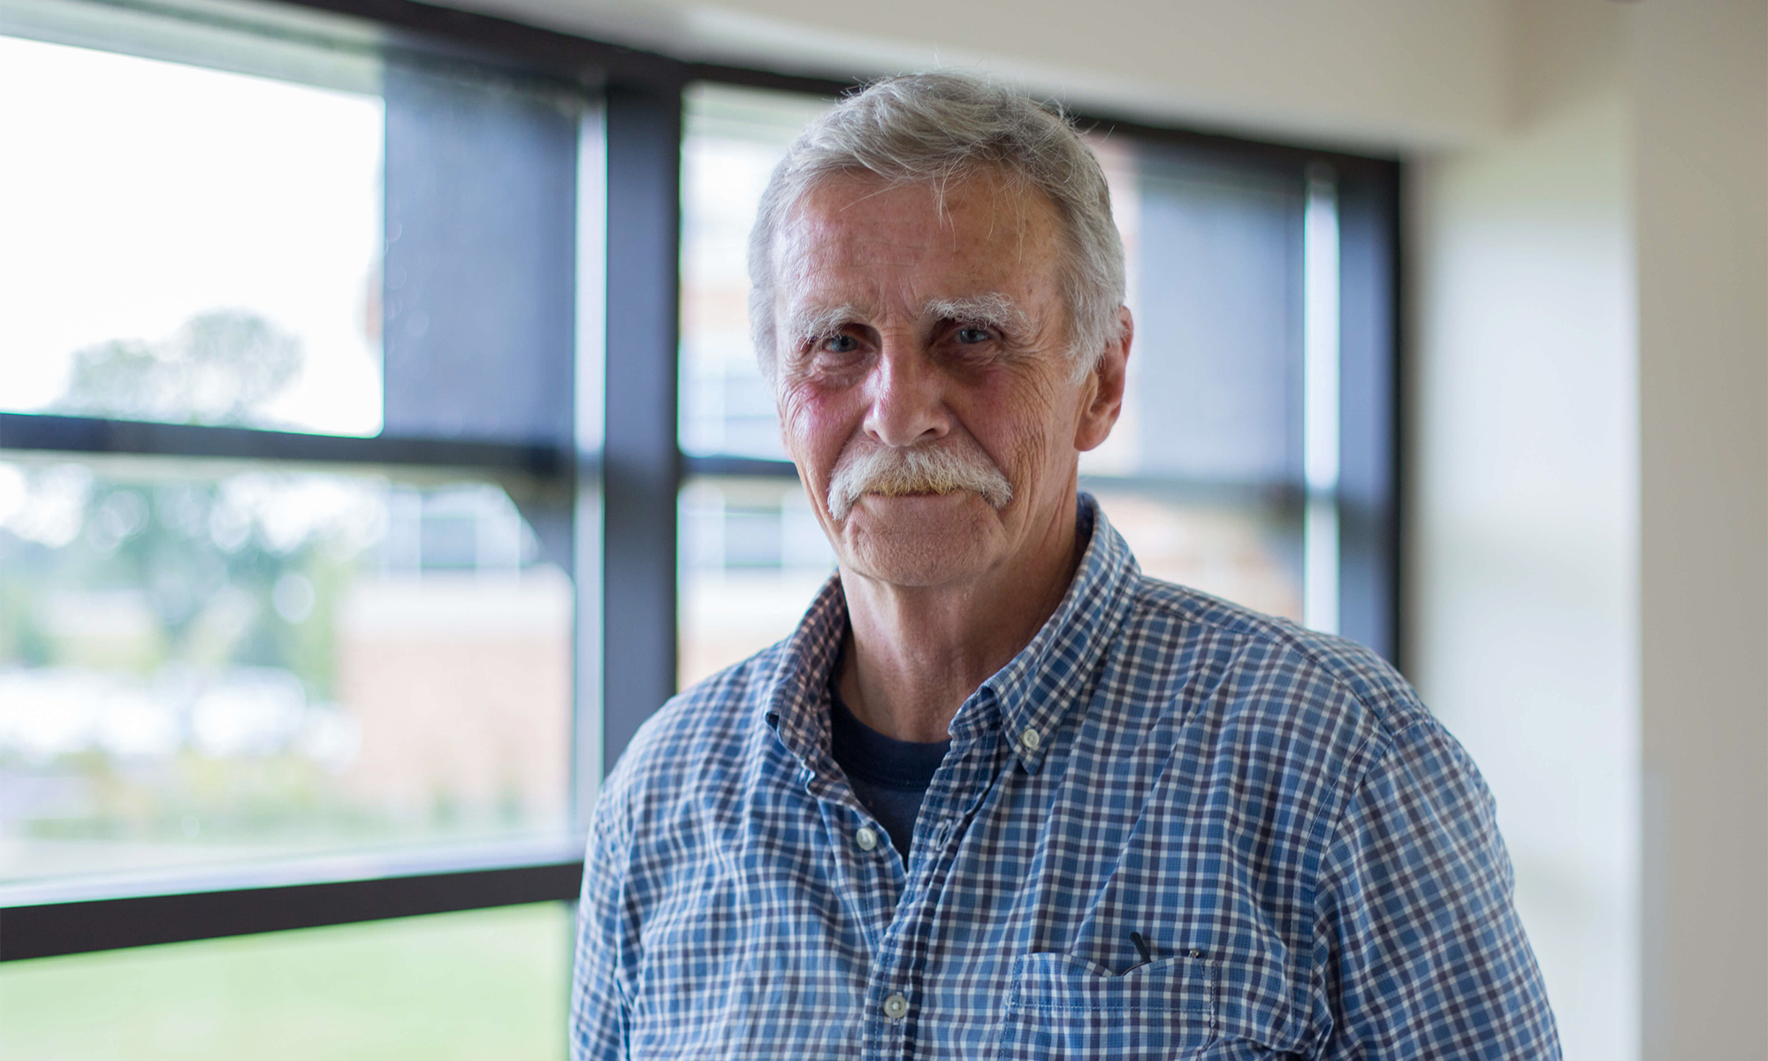
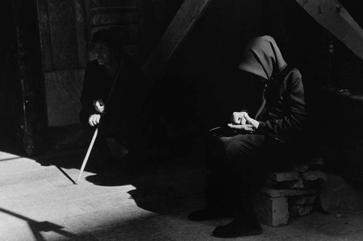
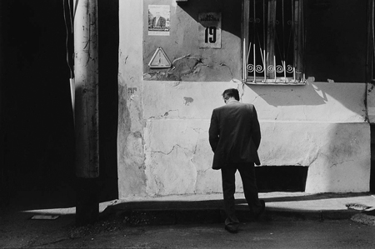
Cultural context of Paul Calhoun
While both Fan Ho and Paul Calhoun are internationally recognized photographers, Paul Calhoun resides locally in Milwaukee, Wisconsin. Besides knowing that he resides in the same city as myself there is not a wealth of knowledge on his childhood and his influences. However, Paul Calhoun earned a Master of Fine Arts Degree from the City University of New York in 1983 but ended up becoming a community/political organizer. Similar to Fan Ho photography was not his chosen medium, but when he was 25 and was feeling rather uninspired with his organizational work he began to take photos for the different organizations he worked for. Later he began to discover the artistic and personal side of photography and became very displeased with working commercially. Due to the lack of development on the newer age of digital cameras, Paul Calhoun also worked with 35mm film and drew his initial inspiration from the work of W. Eugene Smith, an American photojournalist. Paul Calhoun doesn’t use a specific process or technique when it comes to taking photos, he rather develops an idea or theme that regards a location or situation and then proceeds to read and research on this topic before going out to shoot it.
Portrait of Paul Calhoun, 2018, Concordia University
blog.cuw.edu/a-snapshot-of-the-future-a-conversation-with-paul-calhoun/.
He tends to work on extended projects so that he can go back and revisit a location or situation to get a new set of eyes on it. He takes photos of people that have commonly untold stories such as the homeless, or immigrants. His wife is an immigrant and this has driven him to pursue giving and creating for minorities and children at disadvantage in Milwaukee, Wisconsin. Many pieces depict emotional aspects of life.
“While shooting I work at being responsive to what is around me, and trust that in the end the photographs will be reflective of who I am...” – Paul Calhoun
Counting Change, Paul Calhoun
Unemployed, Paul Calhoun

Slide 7
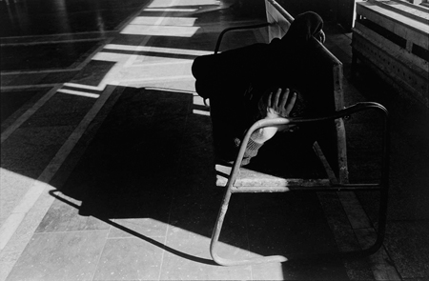
Analysis of Calhoun’s Formal Qualities
Unemployed, Paul Calhoun
Counting Change, Paul Calhoun
RR Station, Paul Calhoun
Composition: Paul Calhoun composes his shots in many different ways as to appeal to different emotions and tell different stories. In this shot you can see he has isolated the subject show that he is alone in his struggle to find employment. Not only that the man faces away from the camera with his face directed at the ground which plays on the feelings of shame or guilt regarding the issue. Many of his shots are asymmetrical which forces the audience to search about the photo. Many subjects are shrouded in shadows to convey the darkness of their situation.
Color: Calhoun shoots in both color film and black and white however the majority of his portfolio is purely black and white and he has stated that it is his preferred medium of photography. Many of his pieces feature dark tones to convey a theme of human struggles not being brought to light and discussed because it is not socially accepted in America. Calhoun shoots in film and pushes many of his shots to have darker shadows and whiter lights as to create heavy contrasts that show the contrast between the economic and racial classes that society enforces.
Context: Without the titles to his work it would be very confusing to understand what message Calhoun is trying to communicate with a photo, however with his expressionist style the emotion being illustrated is always clear to the viewer. In this piece RR Station you can see a man sleeping on a bench alone, this conveys a bit of irony seeing as railroad stations are typically full of people that are travelling. However, it is clear that this man has missed the train of life and now has made the station a home. A common theme in his work is struggle, and that is his framework for context.

Slide 8
Interpretation of function and purpose
Unemployed by Paul Calhoun holds some very sobering themes that seek to enlighten the viewer about the struggles of those around you that do not have a voice. This wall that may typically be filled with advertisements or events and happenings is now bleak and out of order. The wall is no longer a news source and thus the man has no reason to look up and is now caught gazing hopelessly at the ground.
Interestingly enough Calhoun has decided to photograph a single person for this piece centered around unemployment. Only one person is used to show that they struggle alone and many times cannot find help to become employed again. Additionally the subject is formally dressed man, men are often seen as providers by society and when a man loses his work it may seem like he has lost everything and thus stays in uniform.
When looking at the shot as a whole the drama becomes much more apparent. The shadows are dark and soak up the light like a sponge, the man himself is even shrouded in shadows being cast by tall buildings. Perhaps the buildings shadowing him are meant to be interpreted as a rising upper class that is leaving the unemployed behind and without hope. In addition the man has his head dropped to the ground when clearly there is nothing to be looked at on the ground, because he has nothing to look forward to.
The barred windows show the insecurity of the area and help convey the job insecurity of the era. Many of Calhouns pieces and series seek to show the struggles of minorities, immigrants, the homeless, and in general those without a voice. The areas where these people live are often hostile and not safe, the bars show the barring of these people groups in modern society. Calhoun hopes to break down these walls by helping the voiceless have their struggles expressed.
Unemployed, Paul Calhoun

Slide 9
Interpretation of function and purpose
Light is such an important tool in a photographers tool box and Paul Calhoun uses light to guide the viewers eyes right to the subject of the piece: the change being counted. The change counter is wearing dark clothes and hood that hides their face as though they are trying to hide their face from the world. This lack of identity is a common theme amongst Paul Calhoun’s works and shows the lack of representation of different social groups such as the homeless. Now by having two figures present in this photo Calhoun begins to tell a bit of a different narrative one in which there is some form of relationship. This hooded figure could be a spouse, a parent, a companion, a beggar, or just person but their seems to be some sort of relationship between the two persons. The person on the left also appears to have a cane which implies a disability.
It is always interesting when a photographer who primarily shoots in color decides to switch over to black and white, it makes you wonder why the change was made. The contrast of the light and dark is a representation of the juxtaposition between the rich and the poor. Calhoun being from Milwaukee, Wisconsin is familiar with the poorer areas being heavily contrasted with the rich especially in downtown Milwaukee. One block is a project and the next is filled with fancy restraunts. Here it can be seen that the person is simply sitting on a ply of bricks and rubble which shows the disparity of the situation. The person seems to have built this chair implying that this isn’t the only time that they sit here to count their change. Counting change is frequently seen as something people do if they’re worried about their money or not lenient when it comes to spending.
Counting Change, Paul Calhoun

Slide 10
Comparison of artist’s backgrounds
Paul Calhoun
Paul Calhoun grew up in Milwaukee, Wisconsin an area with plenty of diversity and adversity
Studied art in college but became a political organizer
Shoots in both color and black and white 35mm
Focuses on capturing the point of view of those who are disadvantaged socially, economically, and politically
Shoots worldwide and focuses various cultural groups
Unemployed, Paul Calhoun
Fan ho
Hong Kong Venice , 1962, Fan Ho
Approaching Shadow, 1954, Fan Ho
Raised in Hong Kong during the civil war and mass immigration
Lost ability to write at a young age and picked up photography to calm himself
Shoots solely in 35mm black and white film on a Rolleiflex
Focuses on capturing the people of Hong Kong’s interactions with city
Both
Both artists were raised in big cities with diverse people groups and both artists seek to show these people and their lives within the cities
Both artists moved to photography after being barred from their chosen careers, and shoot 35mm film
Counting Change, Paul Calhoun

Slide 11
Comparison of artist’s formal qualities
Paul Calhoun
Both
Fan ho
Uses light as a key point of emphasis for the story being told in his photos (for example he uses light to emphasize a person counting change by keeping the change in the light and the person in the shadow in his piece Counting Change)
Always shoots people as to capture their story and doesn’t always focus on getting the perfect street shot, he’ll shoot what he sees when he sees it
Tends to have more organic lines and shapes in his work as the urban areas he shoots tend to be dilapidated
His work is all contemporary realism and photo journalism which means he doesn’t edit his photos in photoshop
Focuses on achieving a sense of balance by using the rule of thirds and other techniques
Use large swooping shadows to cut the edges of the picture out and better frame the subject, or a specific element in the photo
Both artists shot in black and white film for the pieces being studied to deprive the photo of color and rely more heavily on tactile subtilties like texture and balance
Is well known for waiting for hours for the right subject to come to his planned out spot
Uses darkrooms and photoshop to make composite images and create stark contrasts with light
Never shows a subjects face but rather shows a massive rising city around the subject as to show the interaction between the person and city rather than just one or the other
Composes his shots so that the person is always dwarfed a never filling the frame
Shoots only in black and white and uses heavy amounts of environmental texture
Tends to find balance through more symmetrical compositions that focus on the structure of the environment rather than the place of the subject
Both artists avoid the face of the subject as to keep the purity of the human form and more so show a universal emotions like fate or a lack of hope
Use natural leading lines like shadows and walls as guides
Unemployed, Paul Calhoun
Approaching Shadow, 1954, Fan Ho

Slide 12
Comparison of line usage
Paul Calhoun
Fan ho
Lines are much more organic and have curves in them rather than being completely straight and geometric
Some lines are quite soft and are casted by gentle that are meant to show gradual tone changes as opposed to sharp contrasts
Lines made by humans are sloped and organic and many times direct the viewer to the ground
Straight lines are used as levels to frame the subject and create balance
Fan Ho is much more directional with his line usage and creates lines directly towards the subject even if they don’t naturally exist in the raw shot
Sometimes his lines are rather thick and end up becoming makeshift paths that lead your eyes through the photo and towards the details
The more organic lines tend to be found in clusters and are made by ripples or rubble found throughout the streets of Hong Kong
Approaching Shadow, 1954, Fan Ho
Unemployed, Paul Calhoun
Both
While both of these artists have unique ways of framing their subjects and guiding the viewer through the photo they both use lines to isolate specific elements within the photo
Frequently you follow a soft gradation into a hard leading line that is created by the stark form of a person
Shooting in black and white requires the artist to use lines more actively in their work
Counting Change, Paul Calhoun
Hong Kong Venice , 1962, Fan Ho

Slide 13
Comparison of function and purpose
Unemployed, Paul Calhoun
Counting Change, Paul Calhoun
Hong Kong Venice , 1962, Fan Ho
Approaching Shadow, 1954, Fan Ho
Paul Calhoun
Both
Fan ho
Both pieces are used to shine light on the troubled financial and economic states of a people group, neither piece indicates a specific people group so perhaps the pieces are simply referring to the poor
Both pieces so the subjects shrouded in shadow with only parts of them out of the shadow and this implies that the subjects have been cast into darkness by society and are without a voice
Both artists strip the personal qualities from the subjects as to more so focus on what their struggle is
Both artists want to show a journey in their artworks and both tend to focus on more mature and grim themes that do not exactly have happy resolutions to them
Both show the struggles of urban dwellers as opposed to other walks of life
Fan Ho uses light to obscure the personal and unique features of a person out of the shot and just them as a human, this is meant to convey the way a big city can strip the individuality from a person
His pieces are meant to show people on a journey or approaching a destination like the rickshaw man travelling down the river or the woman waiting to meet her fate of old age

Slide 14
Comparison of cultural contexts: unemployed and Hong Kong Venice
unemployed
Both
Hong kong venice
Between 2003 and 2005 Milwaukee, Wisconsin saw a high concentration of students living in poverty all left in MPS as opposed to be scattered across other school districts
Paul Calhoun has a heart for kids as his own children were bullied in school for being mixed race individuals
Unemployment seeks to show the despair the parents or providers of these children may be in as they search for a place to work
Milwaukee in particular has one of the worst income inequality rates of any city in the U.S and this is part of Paul Calhoun’s motivation to give these people voice through his internationally recognized portfolios
The person also being a man is culturally significant as men make up over 60% of the homeless population
These photographs were both captured in large cities where many details go overlooked, such as unemployed persons, pollution, worker safety, and unique forms of transportation
Both shots seeks to tell the story of an individual, however this story can be applied to the masses when you understand their contexts
Hong Kong Venice comes from across the globe and an entirely different cultural context
Fan Ho was more concerned with expressing his art than giving a voice to people who are in need
While his work doesn’t seek express disadvantaged peoples struggles, Fan Ho still supported his community with is work and helped establish Hong Kong’s camera market and attention to the area
Additionally Fan Ho was primarily active during the 1950’s-60’s which saw a mass immigration and several natural disasters all while industry continued to grow exponentially
The growth of the city and industry is was captivated Fan Ho and that is what can be primarily seen in his works, it harkens back to the industrial era in U.S history
The cities provide contrasted lighting that is ideal for creating juxtaposition of light and dark forms
Both artists use the cities as canvas and the people as the paint to tell their story
Unemployed, Paul Calhoun
Hong Kong Venice , 1962, Fan Ho

Slide 15
Comparison of Formal Qualities: Counting change and Approaching shadow
Counting change
Approaching shadow
The primary elements of art that are used in this piece are value and form, the light in the seen directs the viewer first to the shape of a cane and then over to a pair of hands that appear old and frail and are counting change
The next apparent element would be the variated use of lines throughout the piece
At the bottom of the photo there are soft lines created by the soft shadow, but when you follow those lines up the photo you are greeted by sharp and industrial lines that cut the shadow with stark black
Using shadow to cover the background of the piece truly makes the viewer appreciate the human forms in the foreground of the image
Approaching Shadow is a totally different animal when it comes to composition and use of lines
Unlike the majority of Fan Ho’s work Approaching Shadow was a setup shot that he captured while walking a long a bay with his female cousin, he framed tightly in the corner of the shot against two walls to show that she has her back up again the past and now must look to the future
The large wall in the foreground was actually pure white but Fan Ho was a master manipulator and knew the regions shadows so well that he added his own shadow while in the darkroom
The piece also takes advantage of the walls nice grainy texture that gives more unity to the piece
Counting Change, Paul Calhoun
Both
Approaching Shadow, 1954, Fan Ho
Both shots use very implicit lines created by shadows to direct the viewers attention to the subjects of the pieces
These shots are both 50% shadow which is typically a risk many film photographers won’t take because it becomes harder to balance the composition
Both use texture and form to create better unity in the piece, Fan Ho using the wall and Paul Calhoun utilizing the hands and cloth

Slide 16
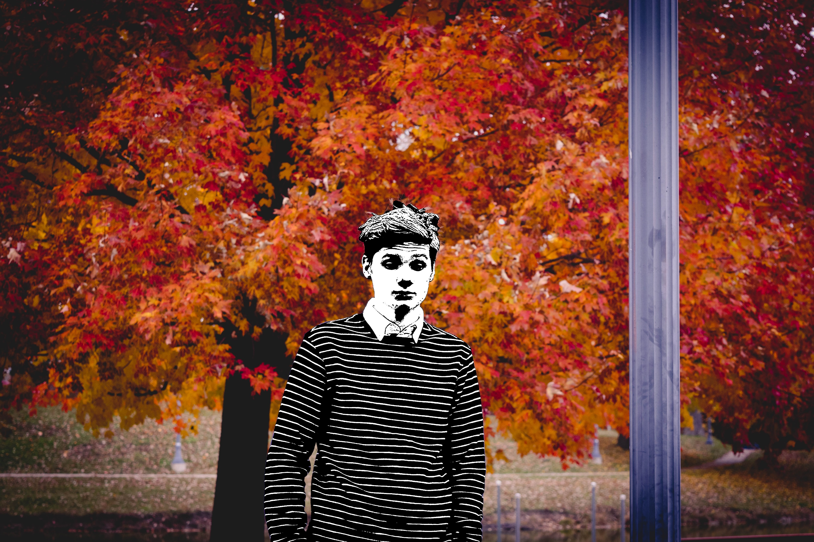
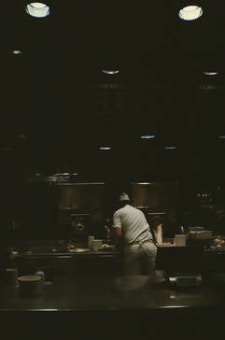
Personal Artwork and Fan ho: Function, Purpose, and meaning
Model 685, 2018, Henry Locke
At Work, 2018, Henry Locke
Fan Ho was a huge inspiration to me when creating artworks (specifically photographs) during my senior year or IB art. And more importantly many of his works act as a microphone to a larger topic at whether it be death, or lost dreams, or a struggle with self-confidence and individuality. My piece Model 685 represents the poor working conditions of models and in general the desensitization teens have towards media and the way they represented everyday without much of a choice. My second piece At Work is a film shot of an un-posed man working at the end of his shift, ironically he is working at an ice cream place even though the shot is dark and dreary and does not feel happy. Both Fan Ho and myself do not need a persons individual features to represent the meaning of our pieces and in fact it would be a hinderance to know such details.
Hong Kong Venice , 1962, Fan Ho
Approaching Shadow, 1954, Fan Ho

Slide 17
Personal Artwork and Fan ho: Formal Qualities and technique
Similarities
Both Fan Ho and myself use industrial and geometric lines to point the viewer the viewer to a certain portion of the shot
Both of use tend to opt for an asymmetrical balance in our shots but find balance through color, texture, and unity
I use Photoshop to process many of my pieces, a tool that Fan Ho just began to use towards the end of his life
I use photoshop to remove color from my subject as to better structure the meaning of the piece and add emphasis
Fan Ho used photoshop to create shadows that didn’t exist and to greater bring out the grainy textures of the city of Hong Kong
Fan Ho shot in film and his photos were naturally in black and white because of the film he used where as I shot this photo with digital camera and then added all of the unique colors in the post production of the photo
Both photographs have heavily saturated backgrounds
Model 685, 2018, Henry Locke
Approaching Shadow, 1954, Fan Ho

Slide 18
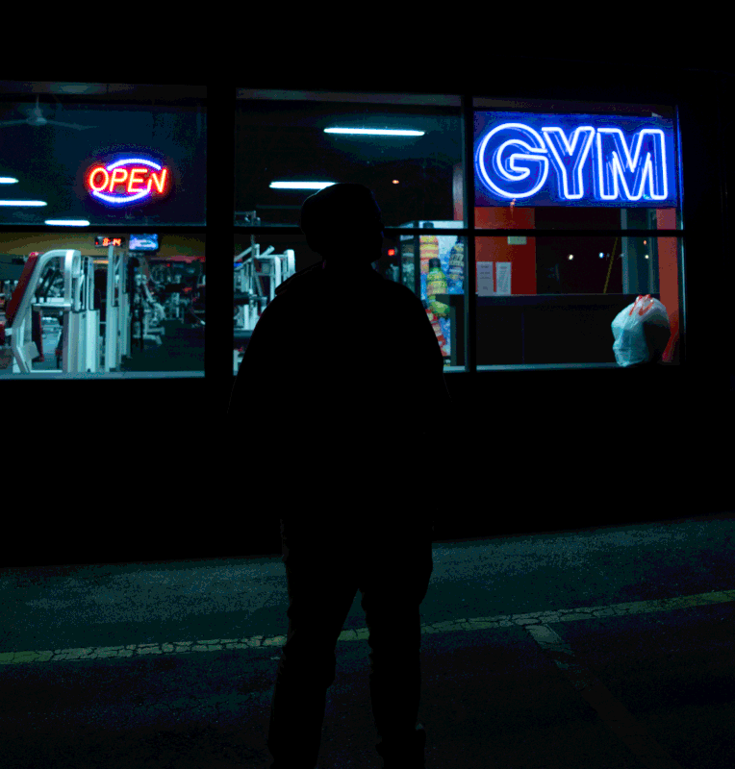
Personal Artwork and Paul Calhoun: comparing artistic styles
Unemployed, Paul Calhoun
Open Perspective, 2018, Henry Locke
At Work, 2018, Henry Locke
Model 685, 2018, Henry Locke
Style takes a lot of time to develop so naturally the longer you are alive and working on your desired style the more developed and concise that style will be. Paul Calhoun has primarily dark style that has very saturated shadows and eerily lit scenes, even in his color photos. Another part of your style is who you choose to show and what they mean to you. Calhoun chooses to show minorities, the homeless, immigrants, broken families, and other groups of people who are struggling with everyday life due to some form of societal disadvantage. Now once again this style is very unique to him seeing as he started as a political organizer and then moved over to the world of photography and married an immigrant. I too live in Milwaukee but have not quite developed a certain kind of person or thing that I desire to photograph. My photos while they may show color they do not necessarily indicate clearly who the subject is and I quite like this about my current style. I hope to keep the viewer in the dark about the identity of the model or stranger and make them work to find their own answer.
Counting Change, Paul Calhoun

Slide 19
Personal Artwork and Paul Calhoun: comparing Formal qualities and technique
Open Perspective, 2018, Henry Locke
At Work, 2018, Henry Locke
Unemployed, Paul Calhoun
Counting Change, Paul Calhoun
My work also features the silhouettes that Paul Calhoun is so famous for
My shots have saturated shadows that eat up the edges of the phot and frame the subject like Calhoun
My shots have bright points of emphasis like the mans shirts in At Work or the bright neon “OPEN” sign in Open Perspective
Unlike my own Paul Calhoun has a sense of mystery about his characters. Mine are just unknown and shadowed out while he gives you better hints about whose his people might be
Calhoun has better uses of soft shadows that turn into drastic contrasts where as my soft shadows tend to never end
Calhoun’s composition better applies the rule of thirds with people or lines being placed at each third mark while my photos are near dead centered

Slide 20
Connections Between the artists
Fan Ho, Paul Calhoun, and myself all work across the same medium using light, leading lines present in the environment, people from all walks of life, shadows, and forms to create an image that tells a story. While the stories we may be telling are all different there is something essential about all three artists that is the same. Paul Calhoun captures this similarity perfectly with this quote “While shooting I work at being responsive to what is around me, and trust that in the end the photographs will be reflective of who I am...” (Interview with Paul Calhoun). So while all of these may just be reflections of who we are as people and artists there are other things that draw our works together such as our appreciation for deep shadows in our photos. Fan Ho and Paul Calhoun embrace shadow so much that sometimes shadows can be the majority of their compositions, this can also be seen in my piece At Work. Another aspect where our styles overlap is the way we balance our photos with compositional rules but also asymmetrical balances. Calhoun has the most asymmetrical work as he doesn’t set up his shots or wait for the right person to come through at the right time. His photojournalist style requires his photos to show heavy contrasts between light and dark, negative space and positive, and subject and background all the while still be balanced right off the bat. Another aspect that is common place in our work is our use of emphasis and guiding the viewers eye to the subject. Fan Ho uses light shapes to create lines towards his subject, while Paul Calhoun doesn’t use lines as much as he uses illuminating light to direct the viewer and finally I use contrasts made of color and tone to direct the viewer to the subject. Regardless of the time period we live in as artists ours photos seek to share an idea that is timeless in it’s concept and it’s
execution. Finally our intentional juxtapositions are a quality that we share, Fan Ho first did it in his piece Approaching Shadow where he juxtaposes light and dark to show the thin and frail line we walk between life
and death.
Open Perspective, 2018, Henry Locke
Model 685, 2018, Henry Locke
At Work, 2018, Henry Locke
Counting Change, Paul Calhoun
Unemployed, Paul Calhoun
Hong Kong Venice , 1962, Fan Ho
Approaching Shadow, 1954, Fan Ho

